Slide 1
Production Ready Kubernetes
Weaveworks – https://weave.works – @weaveworks
Kubecon San Diego – 18 NOV 2019
Brice Fernandes – brice@weave.works – @fractallambda

Slide 2

Unless specified, these slides are © Weaveworks 2019.
They are made available under a Creative Common License.
Attribution-NonCommercial-ShareAlike 4.0 International (CC BY-NC-SA 4.0)
You can attribute in the following way:
“Created by Weaveworks / Derived from material create by Weaveworks.
Original available at https://tinyurl.com/kubecon-2019-workshop”

Slide 3
Welcome and Introduction

Slide 4

I’m Brice
I work for Weaveworks
You can find Weaveworks at https://weave.works
or @weaveworks
The team at Weaveworks is behind the GitOps model
You can find me online at @fractallambda

Slide 5
WIFI: LogDNALovesDevs
Pass: cloudnative
Today’s slides:
https://tinyurl.com/kubecon-2019-workshop

Slide 6
Aim of this workshop
We don’t have enough time to go through everything you need in a single day.
I’ve tried to highlight the most valuable concepts for production. Value over depth for production.
I hope you’ll walk away with a good approach to tackling production Kubernetes, but you’ll need to go over many of the issues we discuss today in your company.

Slide 7
Agenda
09:00 | Welcome & introduction
09:30 | Getting started with your environment
10:00 | The Production Ready Checklist
11:00 | Break (15 minutes)
11:15 | Monitoring a production cluster
11:45 | Introduction to GitOps
13:00 | Lunch (1 hour)
14:00 | GitOps in Practice
15:00 | Advanced Deployment Patterns
15:30 | Break (15 minutes)
15:45 | Enterprise Architecture Patterns
16:15 | Securing a Kubernetes Cluster
17:00 | Review and recap

Slide 8
Some assumptions
You can use the command line.
You can use Git.
You know what Pods, Deployment, and Services are.
You have a modern web browser.
You have an account on Github (Bitbucket, Gitlab, etc...)

Slide 9
Getting started with your environment

Slide 10

Setting up a GKE cluster

Slide 11
Checkpoint:
Logged into the GCP console

Slide 12
Checkpoint:
Kubernetes Cluster
running in GCP

Slide 13
GitOps hands-on 1/10
💻
Kick the tires on your cluster
Start with a simple command:
➤ kubectl version
Look at what’s running on the cluster with
➤ kubectl get pods --all-namespaces

Slide 14
The Production Ready Checklist
https://tinyurl.com/k8s-production-checklist

Slide 15
Setting up a workshop cluster
https://tinyurl.com/k8s-workshop-setup

Slide 16

Coffee
Time

Slide 17
Monitoring a Production Cluster

Slide 18
Introduction to Prometheus
https://tinyurl.com/monitoring-with-prometheus

Slide 19
Hands-on with Prometheus
https://tinyurl.com/hands-on-prometheus

Slide 20
Introduction to GitOps
https://tinyurl.com/introduction-to-gitops

Slide 21

Lunch
Time
Notes:
> Finish the enterprise slides
> Add some Operations slides

Slide 22
GitOps in Practice
https://tinyurl.com/gitops-in-practice

Slide 23
Advanced Deployment Patterns
https://tinyurl.com/k8s-advanced-deployments

Slide 24
Coffee
Time

Slide 25
Enterprise Architecture Patterns
https://tinyurl.com/kubernetes-enterprise-patterns

Slide 26
Securing a Kubernetes Cluster
https://tinyurl.com/k8s-security-intro

Slide 27
Review and Recap

Slide 28
Agenda
09:00 | Welcome & introduction
09:30 | Getting started with your environment
10:00 | The Production Ready Checklist
11:00 | Break (15 minutes)
11:15 | Monitoring a production cluster
11:45 | Introduction to GitOps
13:00 | Lunch (1 hour)
14:00 | GitOps in Practice
15:00 | Advanced Deployment Patterns
15:30 | Break (15 minutes)
15:45 | Enterprise Architecture Patterns
16:15 | Securing a Kubernetes Cluster
17:00 | Review and recap

Slide 29
Now, Delete your GCP clusters!
Don’t forget this or they will continue to cost you credits

Slide 30
We ❤️ Feedback
Please complete the survey
tinyurl.com/kubecon-workshop-feedback-19

Slide 31
About Weaveworks

Slide 32
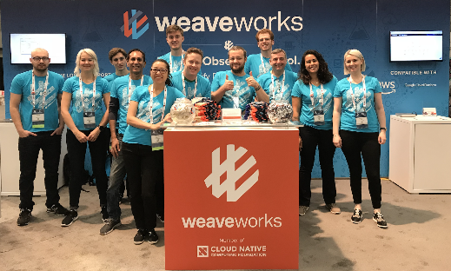
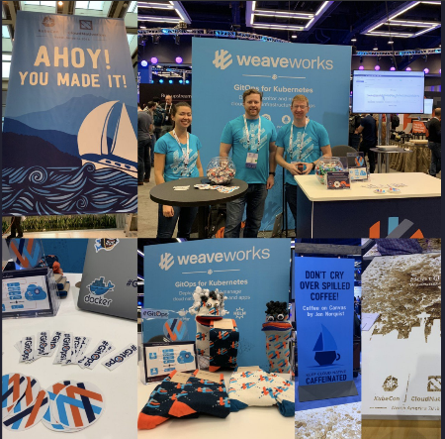









Weaveworks
Team
Customers & Partners
Leading Investors
Alexis Richardson, CEO and CNCF TOC founding chair
Matthias Radestock, CTO
Steve George, COO
50+ Person Global Team
Enterprise Customers: Fidelity, ATD, Bose, ISC, ATB, GE & more
Consulting partner: Oliver Wyman
Technology partnerships: AWS
Founded in 2014
Unique in having both AWS and Google as investors along with top tier VCs

Slide 33


AWS & Weaveworks Partnership Overview
The primary focus of the AWS and Weaveworks strategic partnership is to accelerate the transition of Kubernetes users to Amazon EKS via the development and joint promotion of both tools and professional services.
Weaveworks and AWS aim to grow recurring revenue through the success of this initiative by offering their respective subscriptions to customers transitioning to EKS.
Jointly, AWS and Weaveworks will position themselves as the leaders for Kubernetes using the GitOps model for cluster management and application life-cycle management.
+

Slide 34
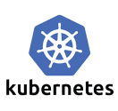


















Weaveworks is a Leader in Open Source & Cloud Native
Kubernetes | Weaveworks led the creation of the flagship Kubernetes installer Kubeadm
 | Weaveworks created EKSctl – the official EKS CLI enabling GitOps on AWS
 | Weave Net - the original container SDN & Firewall LibCNI Kubernetes network model - work with CoreOS (now RH/IBM)
 | Weave Ignite - the container VM for secure, fast Kubernetes anywhere
Observability | Weaveworks made Prometheus scalable with Weave Cortex & launched 1st Prom-aaS, powering EA’s global games. Cortex is now a CNCF project.
 | Weave Scope is is one of the ”top tools for monitoring Kubernetes” providing management and monitoring and visualization for <20,000 users
CD and GitOps tooling | CNCF Flux is a Kubernetes-native CD tool for GitOps - also Flux-Helm. Weave Flagger for progressive delivery JKcfg for templating, policy and actions
 | Kubediff - diff alerting for Kubernetes to enable GitOps Kured - Cluster Reboot Tool Grafanalib - GitOps dashboarding for Grafana
Integrations | Weaveworks for: Istio, Kubeflow, LinkerD, OpenFaaS, Cloud Foundry

Slide 35

Evaluation & Assessment
Training & Certification
Platform
DevOps
Weaveworks Consulting, Training & CRE Service
Weave Kubernetes Platform (Core)
Weave Kubernetes Platform (DevOps)
Evaluate current K8s and deployment pipeline technology
Assess how well the current implementation is accomplishing its goals
Guide technology decisions
Advise w/ regards to cloud services and open source partners
Develop cloud native reference architecture
>> Get started fast
Training customer teams: workshops + dev support
Set up initial clusters and applications
Advanced support and optimizations for new demands
>> Rapidly roll out K8s dev clusters for app teams including dev tooling
Deploy & upgrade K8s clusters in EKS or on prem
Establish Config, Compliance & Audit, & Security
Runbooks & support
24/7 Support
>> Evaluated for production compliance (data + apps)
App developer platform templates, add-ons, & config
Policy-based Automation, Management and Continuous Delivery
App Monitoring and App Operations extending Prometheus
2-3X app dev team acceleration with compliance
>> Designate Production Ready & Resilient (D/R)

Slide 36
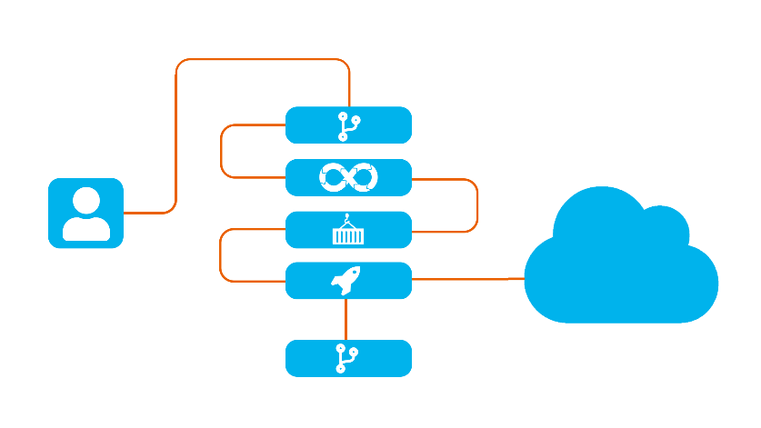
Professional Services
Weaveworks provides Consulting Services
K8s Evaluation & Assessments
Advice for Customer Specific GitOps Implementations & PoCs
Custom Tooling Implementations
Weaveworks’ Customer Reliability Engineers (CRE)
Dedicated K8s CRE or Named Fractional CRE
On Demand or Production 24/7 support
Managed Services (including KOPs migration)
Weaveworks provides Platinum Solution Support
Production Kubernetes - “whole stack” support - resolve application, cluster and extension issues around managed Kubernetes including EKS and other managed K8s distributions
Other CNCF certified open source software 24/7

Slide 37
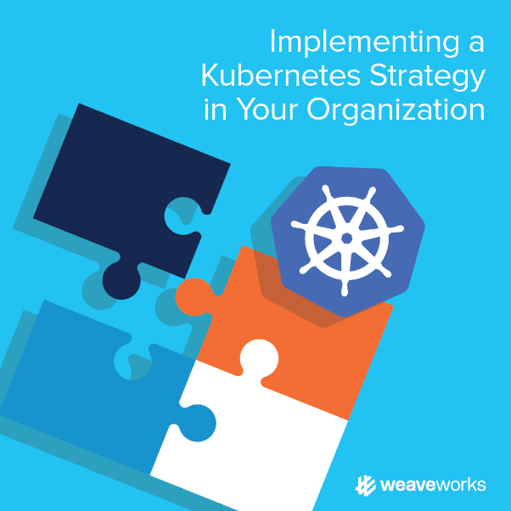
EKS + GitOps Training & Certification
Education, Training & Architecture
Training and consulting goes hand in hand; the output of an architectural evaluation and assessment engagement is to build a roadmap that sets the customer’s DevOps and application development teams up for success
Our seasoned instructors offer hands on workshops that cover topics from the fundamentals to advanced operations; all customized to address the customer’s specific implementation and with GitOps certification upon successful completion
By engaging customer teams in every stage of the process, we create subject matter experts that can successfully operate EKS in production

Slide 38
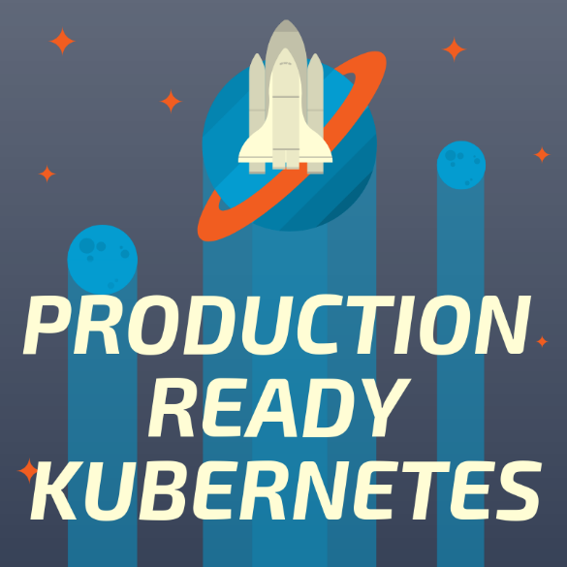
Weaveworks Kubernetes Platform (WKP)
Increases application delivery at enterprise scale
Reduces time, effort and errors to create, update and manage production ready clusters
Provides dashboards to quickly understand clusters, verify correct updates, and alert on incorrect state
Simple ways for developers to define apps, templates, fleets and minimize “YAML hell”
Policy automation that ensures only the correct people with the right roles can change specific settings in explicit ways
Cluster updates, security patches, add-on updates & other “ops” pain removed

Slide 39
Weave Kubernetes Platform in Detail
PAID
FREE
Weave Kubernetes Platform
K8s App delivery at fleet / multi-cluster scale using GitOps
Configure multiple clusters+addons with policy
Developers can define apps & templates
Deploy apps (CD, PD), validate correctness
Observe deployments, alert on change
Business Model
Enterprise subscription licenses
+ Paid certified add-ons eg. Cortex
+ Cloud SaaS options eg. hosted Cortex for EKS
K8s-Hosted Application Services
CD: Flux-Flagger-JK automation
GUI + ops
Mon: Cortex-Prometheus-Scope
Multi Cluster Automation
Pipeline & Fleet Automation
Advanced Config & Policy
GitOps Dashboards, Validate, Diffs
Weave Certified and Supported Open Source
GitOps for Single Cluster Management
Create, manage, secure and update a cluster
Extend OSS K8s and EKS into a “platform”
Manage env from Git (note: can be air-gapped)
Business Model
Subscription for Platinum Solution Support (CRE)
+ Updates, upgrades, security & certified add-ons
Single Cluster
OSS WKSctl
OSS K8s
OSS EKSctl
AWS EKS
Customer-Managed
AWS-Managed

Slide 40
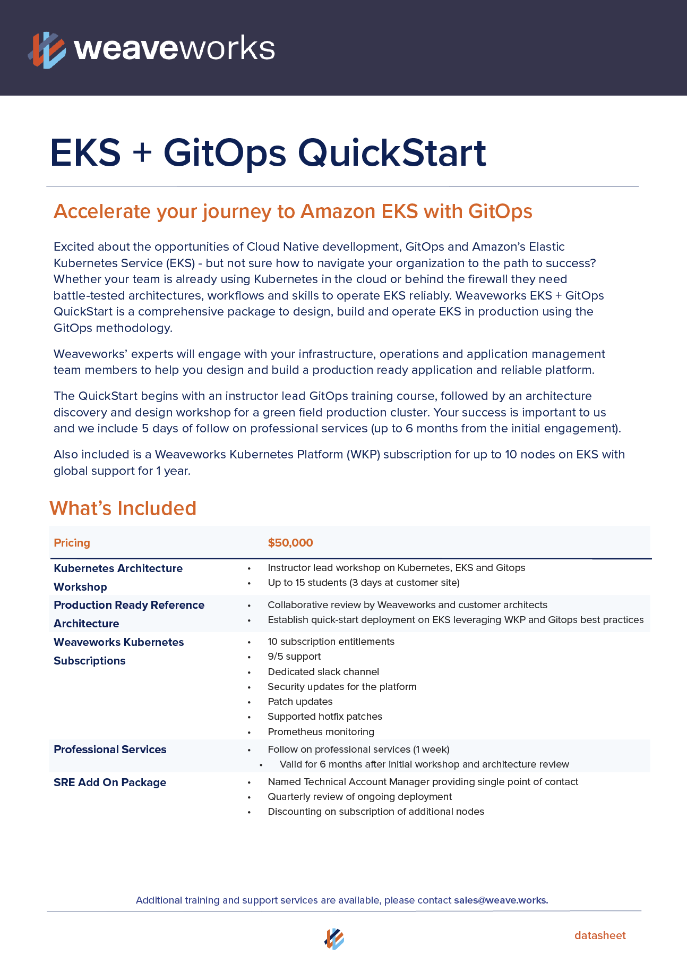
Weaveworks EKS + GitOps Quickstart
Available Today
Includes:
Customer Workshop
Production Ready “Golden Path” GitOps implementation
Architectural Review & Assessment
12 month WKP or Weave Cloud subscription
2 different packages depending on the size of the company

Slide 41

Questions?
Weaveworks
https://weave.works
@weaveworks
@fractallambda
brice@weave.works
tinyurl.com/kubecon-2019-workshop

Slide 42

Home
Time

